Slide 1
AI Act Human oversight

Slide 2
AIA
Title I: General Provisions
Title II: Prohibited AI Practices
Title III: High-risk systems
Title IV: Transparency obligations for certain systems
Title V: Measures in support of innovation
Title VI: Governance
Title VII: EU database for stand-alone high-risk AI systems
Title VIII: Post-market monitoring, information sharing, market surveillance
Title IX: Codes of Conduct
Title X: Confidentiality and penalties

Slide 3
Chapter 2 Requirements for high risk systems

Slide 4
Chapter 2 Art. 14 Human oversight
High-risk AI systems shall be designed and developed in such a way,
including with appropriate human-machine interface tools,
that they can be effectively overseen by natural persons
during the period in which the AI system is in use.

Slide 5
Chapter 2 Art. 14 Human oversight
Human oversight shall aim at preventing or minimising the risks to health, safety or fundamental rights
that may emerge when a high-risk AI system is used
in accordance with its intended purpose or
under conditions of reasonably foreseeable misuse,
in particular when such risks persist notwithstanding
the application of other requirements set out in this Chapter.

Slide 6
Chapter 2 Art. 14 Human oversight
Human oversight shall be ensured through either one or all of the following measures:
identified and built, when technically feasible, into the high-risk AI system by the provider before it is placed on the market or put into service;
identified by the provider before placing the high-risk AI system on the market or putting it into service and that are appropriate to be implemented by the user.

Slide 7
Chapter 2 Art. 14 Human oversight
The measures referred to in paragraph 3 shall enable the individuals to whom human oversight is assigned to do the following, as appropriate to the circumstances:
fully understand the capacities and limitations of the high-risk AI system and be able to duly monitor its operation, so that signs of anomalies, dysfunctions and unexpected performance can be detected and addressed as soon as possible;
remain aware of the possible tendency of automatically relying or over-relying on the output produced by a high-risk AI system (‘automation bias’), in particular for high-risk AI systems used to provide information or recommendations for decisions to be taken by natural persons;
be able to correctly interpret the high-risk AI system’s output, taking into account in particular the characteristics of the system and the interpretation tools and methods available;
be able to decide, in any particular situation, not to use the high-risk AI system or otherwise disregard, override or reverse the output of the high-risk AI system;
be able to intervene on the operation of the high-risk AI system or interrupt the system through a “stop” button or a similar procedure.

Slide 8
Chapter 2 Art. 14 Human oversight
For high-risk AI systems referred to in point 1(a) of Annex III, the measures referred to in paragraph 3 shall be such as to ensure that, in addition,
no action or decision is taken by the user
on the basis of the identification resulting from the system
unless this has been verified and confirmed by at least two natural persons.
Annex III
Biometric identification and categorisation of natural persons:
AI systems intended to be used for the ‘real-time’ and ‘post’ remote biometric identification of natural persons;

Slide 9
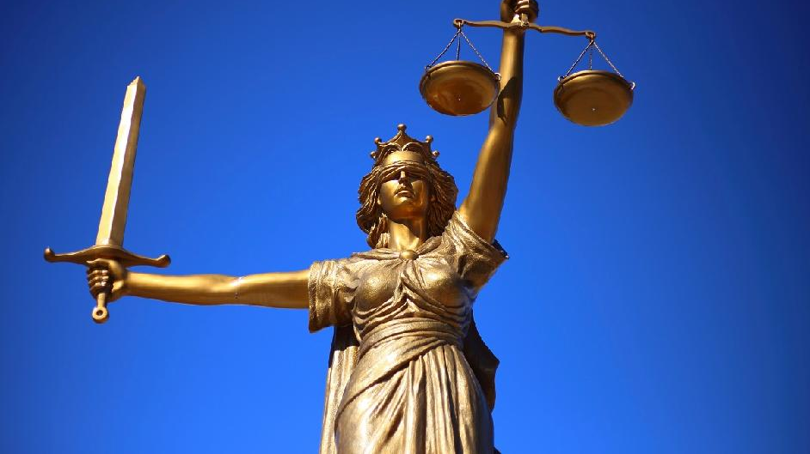
HumanE-AI-NET
AI Act: enables, prohibits, restricts
Reasonable?
Pertinent?

